Slide 1
Why your Startup needs IPRs
EIT Digital Master School @Eötvös Lorand University
Business Development Lab
Inspired by www.forbes.com “The Top 10 Reasons Why Your Startup Needs Patent”

Slide 2
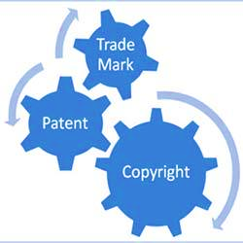
IPRs
Knowledge, creative ideas, or expressions of human mind that have commercial value and are protectable under copyright, patent, trademark, or trade secret laws from imitation, infringement, and dilution.
*http://www.businessdictionary.com/definition/intellectual-property.html

Slide 3

IPRs
Intellectual property includes:
brand names, discoveries, formulas, inventions, knowledge, registered designs, software, and works of artistic, literary, or musical nature.
IPRs are one of the most readily tradable properties in the digital marketplace.
*http://www.businessdictionary.com/definition/intellectual-property.html

Slide 4

Start-up & IPRs
Most start-ups think only about:
How to make a great product,
How to get people to buy it.
Too many overlook the need to protect their IP!

Slide 5
Patents as competitive advantage
Help get funding;
Enhance reputation;
Facilitate joint ventures and partnerships;
Help to go public or being acquired;
Lead to licensing and monetization opportunities.

Slide 6
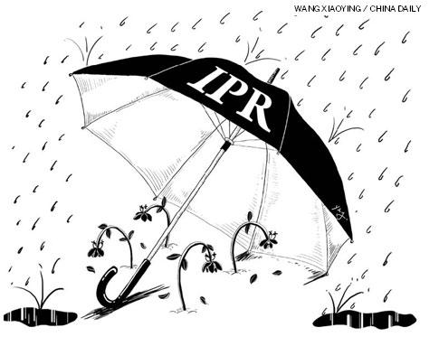
IPRs as a future parachute
To avoid problems as they grow
Start-ups need to incorporate IP into their risk mitigation strategy early
despite the costs they can be the only safety against litigation

Slide 7
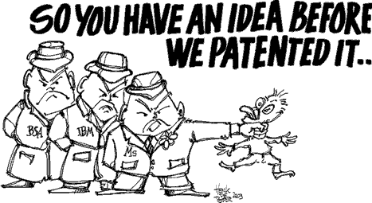
Patent Litigation

Slide 8
Patent Litigation
Litigation is a potent weapon that some competitors use to halt the progress of fast growing companies
Smaller companies are easy targets
They have limited resources and expertise
They are not in a position to deal with large patent risk

Slide 9

Beware of Trolls
As companies grow, they can become targets of "patent trolls“
Frivolous but very costly litigation.
“60% of defendants in non-practicing entity patent suits target companies with less than $100 million in revenue.”*
*See RPX Broker Rundown (May 2016).

Slide 10
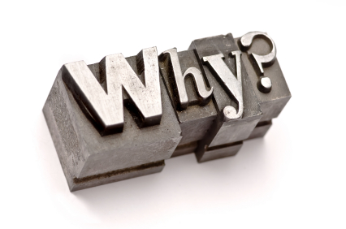



Patents for SW and Tech
SW and tech companies, particularly those focused on content delivery
Are industries with the most rapid innovation
Often ignore the issue of IP protection
Why?

Slide 11
Patents for SW and Tech
Until 2000, most considered software unpatentable.
Supreme Court case Alice Corp. v. CLS Bank Int. (2014) Many believe it made SW ineligible for patent protection
It isn’t true! Patent protection is still available for SW:
Those applications will receive more scrutiny
and need to be carefully drafted

Slide 12
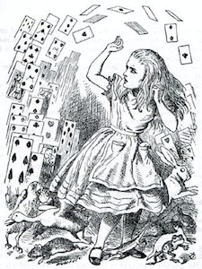
Alice Corporation
Alice Corp. is an Australian company that owns 4 patents, related to a computerized trading platform for financial transactions in which a third party settles obligations between two others to eliminate risk.
When approving those patents the district court assumed that all claims required electronic implementation.
"Alice Corporation v. CLS Bank International." Oyez, https://www.oyez.org/cases/2013/13-298. Accessed 17 Mar. 2017.

Slide 13
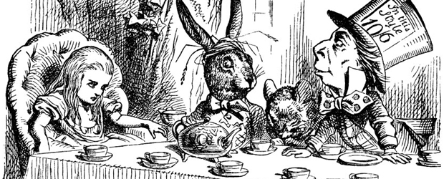
Alice Corp. vs CLS Bank International
On 2007, CLS sued Alice and sought a declaratory judgment of non-infringement and invalidity of 3 of this patents: claims were drawn from ineligible subject.
Alice's patents were declared invalid because they were directed at an abstract idea:
A neutral intermediary to facilitate exchange and eliminate risk.
”Alice Corporation v. CLS Bank International." Oyez, https://www.oyez.org/cases/2013/13-298. Accessed 17 Mar. 2017.

Slide 14
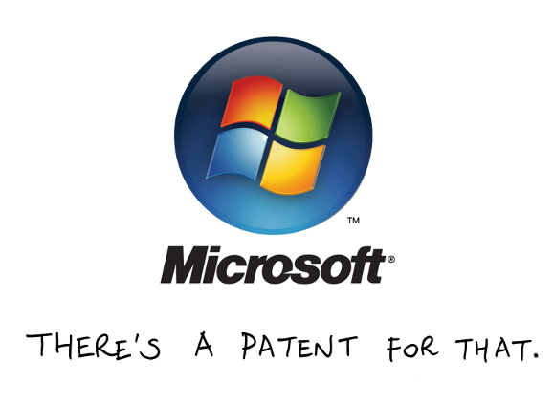

If they DO you MUST!
When Microsoft was a young company they had almost no patents. Now they are one of the most prolific patent filers.
Twitter is known for stating that patents are unimportant, but has been quietly filing patents and accumulating them through acquisitions.

Slide 15
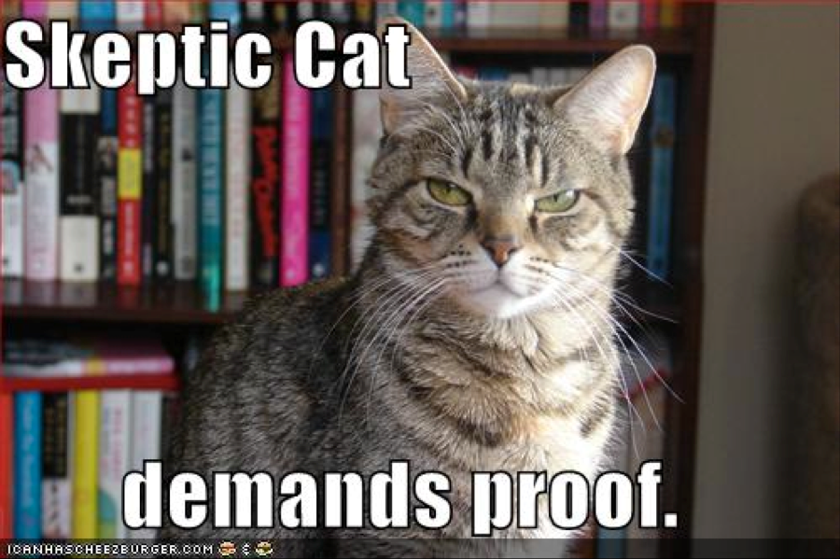

Slide 16
10 Reasons(Good Proofs) for Patenting your Start Up*
1- Facilitate venture capital investment
2- Defending against attacks by rivals
3- Stop the thief
4- Ensure a startup’s freedom
5- Increase market share
6- Form joint ventures and R&D partnerships
7- Increase the chances of an acquisition
8- Get ready for an IPO
9- Long-term success
10- Launch a billion-dollar empire
*https://www.forbes.com/sites/forbesleadershipforum/2015/08/18/the-top-10-reasons-why-your-startup-needs-patents/print/

Slide 17
1- Facilitate venture capital investment
of all startups held patents
of startups receiving VC investment owned patents
of those says patents had been vital for getting investment
*2008 Berkeley study
“Patents are a signal of quality that facilitates access to financing and helps startups overcome the liabilities of newness.”
*Häussler, Carolin, Dietmar Harhoff, and Elisabeth Müller. "To Be Financed or Not…-The Role of Patents for Venture Capital-Financing." (2012).

Slide 18
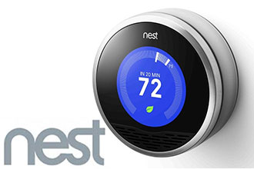
2- Defending against attacks by rivals
2012, Intelligent home products startup Nest introduce its first product, a smart thermostat.
Patent infringement suit from the industry giant Honeywell.
They wanted to “run the upstart competitors out of town simply by exhausting them and their limited resources.”

Slide 19

2- Defending against attacks by rivals
But Nest had already begun patenting its products,
It also acquired 60 third-party patents relating to it from the patent aggregator Intellectual Ventures.
The lawsuit ended in may 2016 with a private cross-license agreement
Honeywell’s goal was to litigate its upstart rival Nest out of business, Nest’s patents have made that impossible.

Slide 20
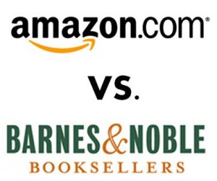
3- Stop the thief
Amazon obtained a patent in 1999 for its “one-click” online purchase system
only 23 days after it filed a patent infringement suit against its then-larger competitor Barnes & Noble
The judge granted an injunction ordering B&N to stop using Amazon’s one-click, giving Amazon the edge in online book retailing.

Slide 21
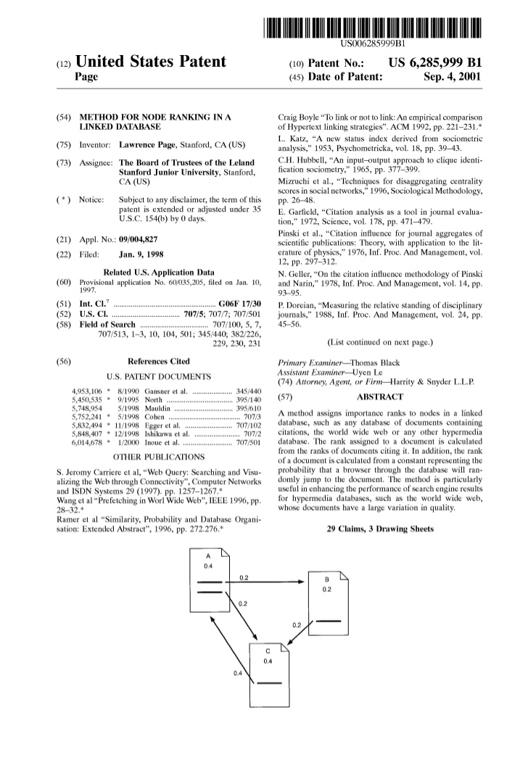
4- Ensure a startup’s freedom
As a startup, in 1998, Google deemed its seminal PageRank patent vital
it filed for it before it had a business plan, venture funding, or even a domain name
then paid Stanford University, to which it had been assigned the patent, $336 million in shares to exclusively license it.
“(Without the patent) Google would have been trampled by copycat search engine offerings from Yahoo, Microsoft, and other big players who once dominated the market.”

Slide 22
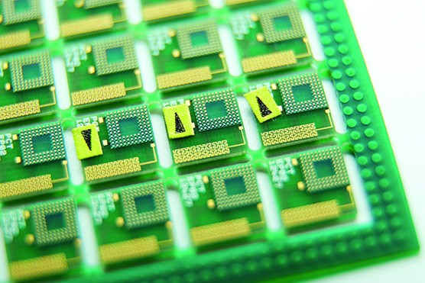
5- Increase market share
Carles Puente invented a mobile phone antenna based on principles of fractal geometry, which allowed it to be much smaller.
His startup, couldn’t possibly manufacture enough antennas for the billions of smartphones sold each year.

Slide 23

5- Increase market share
Thanks to its patents he could license the technology to 90% of the world’s smartphone makers.
“Patents were very important to us in expanding our market share.”

Slide 24
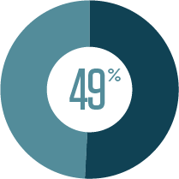
6- Form joint ventures and R&D partnerships
of manufacturing and service firms have used inventions obtained from external sources
of the source was a startup.
In many cases, the patents on those startups’ inventions served as the legal link around which partnerships were constructed.
* 2014 National Science Foundation-backed study

Slide 25
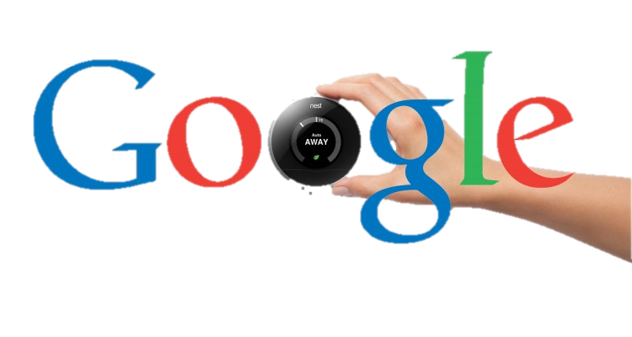
7- Increase the chances of an acquisition
Nest’s intellectual property was a major reason for Google’s acquisition in 2014 for $3.2 billion in cash
“We believe Google would not have purchased the company if it did not have substantial and valuable intellectual property.”*
*an article in USA Today reported, Bernstein Research analyst Carlos Kirjner

Slide 26
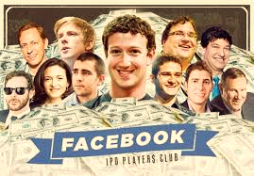
8- Get ready for an IPO
Even Facebook when preparing for its initial public offering, in April 2012,
Spent $550 million to buy 650 former AOL patents owned by Microsoft.
In addition to 750 patents Facebook had bought a month earlier from IBM.

Slide 27

8- Get ready for an IPO
Main objective was to reduce investor concerns over Facebook’s legal risk (but also protect itself against further litigation)
Investors and Wall Street often look at a startup’s patent portfolio.
Patents provide investors security and position a startup for long term growth.
Twitter made a similar patent purchase from IBM shortly after its IPO.

Slide 28

9- Long-term success
“Patents strongly and positively predict the long-run performance of VC-backed IPOs.”*
“VC-backed IPOs with patents substantially outperform other VC-backed IPOs. The same holds true even for non-VC-backed IPOs.”*
“Firms without patent protection are much less likely to survive.”**
*Cao, Jerry, Fuwei Jiang, and Jay R. Ritter. "Patents, Innovation, and Performance of Venture Capital-backed IPOs." (2015).
** Cockburn, Iain M., and Stefan Wagner. "Patents and the Survival of Internet-related IPOs." (2007).

Slide 29
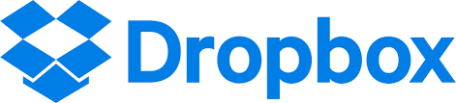
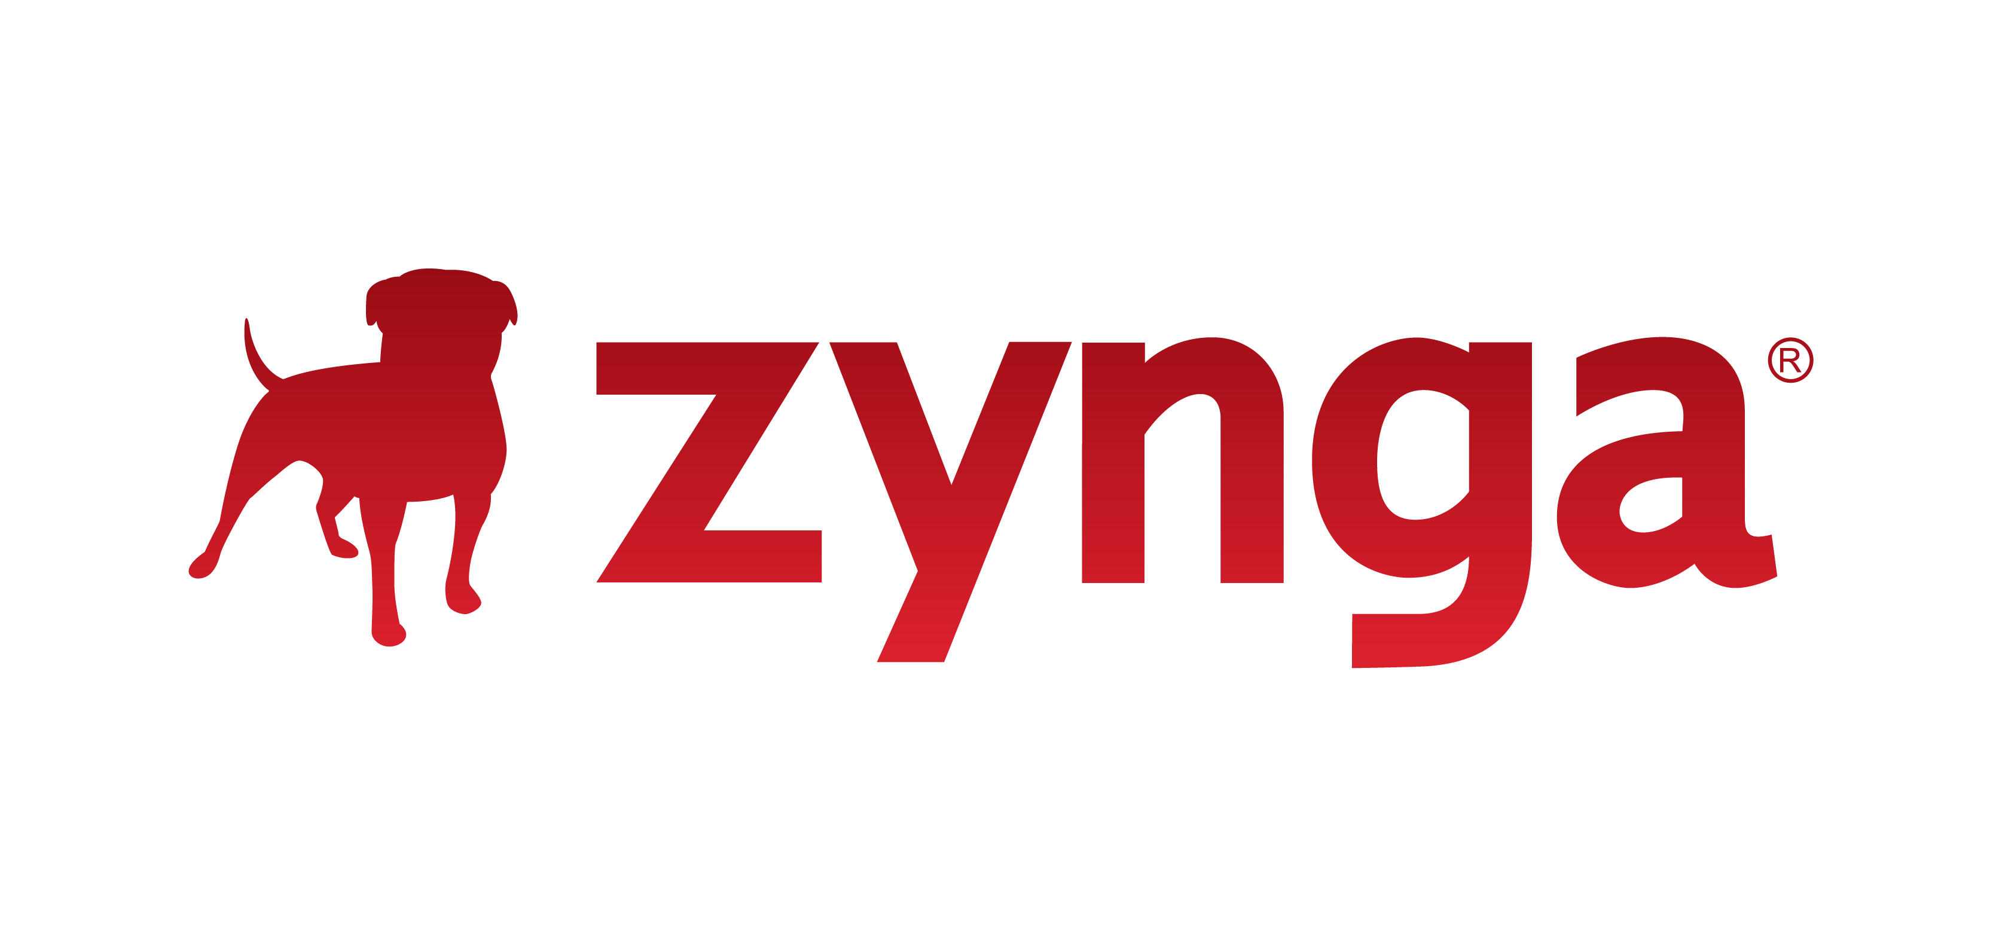
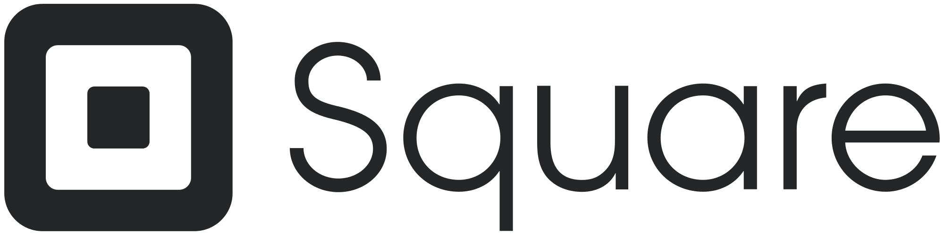
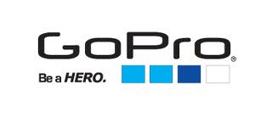
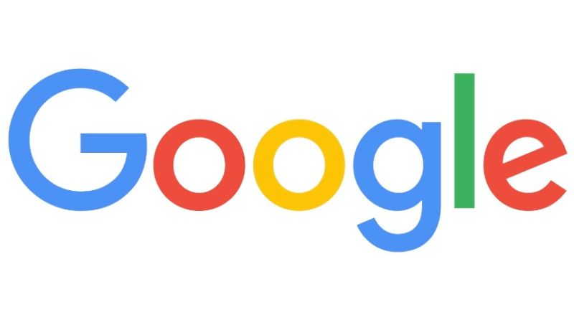
10- Launch a billion-dollar empire
Dropbox’s network folder synchronization patent,
Zynga’s asynchronous challenge gaming patent,
Square’s patented system and method for decoding swipe card signals,
GoPro’s patented harness system for attaching a camera to a user,
Google’s PageRank patent.

Slide 30
What the experts suggest
There is no one silver bullet, companies have different strategies, but all young start-ups should consider this tips:
File patent on your invention/ buy some to fill gaps (be protected)
Be quick and before publicizing the invention or you'll lose patent rights
File all incremental improvements/ features to build a core patent defense

Slide 31
Thank you!
Brought to you by EIT Digital Master School @Eötvös Lorand University
Find me at: anna.reale@inf.elte.hu

